Slide 1

Bringing the Power of the Web to the IoT:
Web of Things and node-wot
Ege Korkan - Global Summit for Node.js'22

Slide 2

A Peculiar YouTube Video Title
https://www.youtube.com/watch?v=BxV14h0kFs0

Slide 3
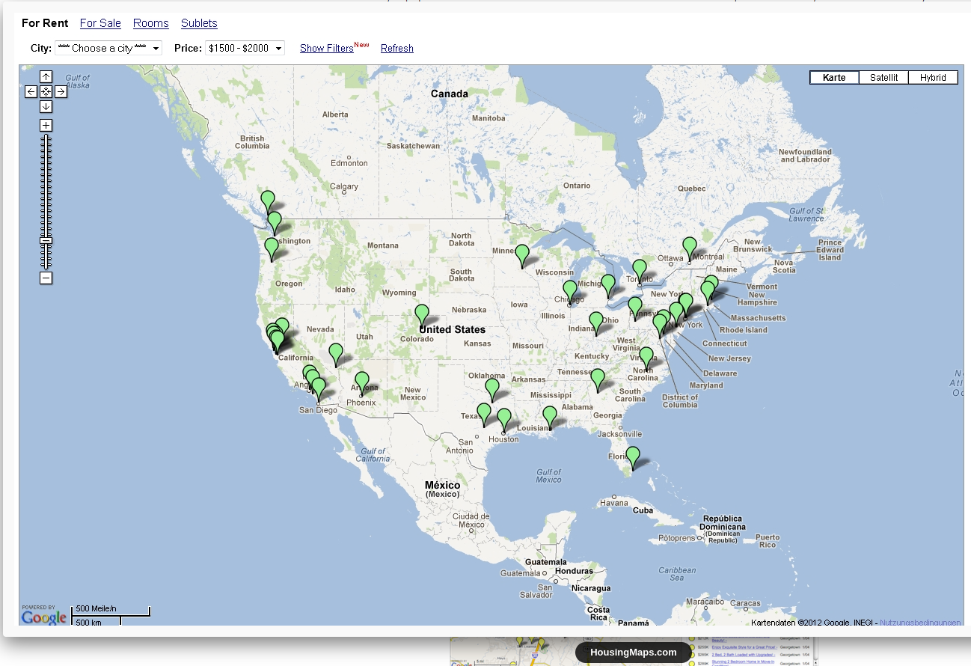

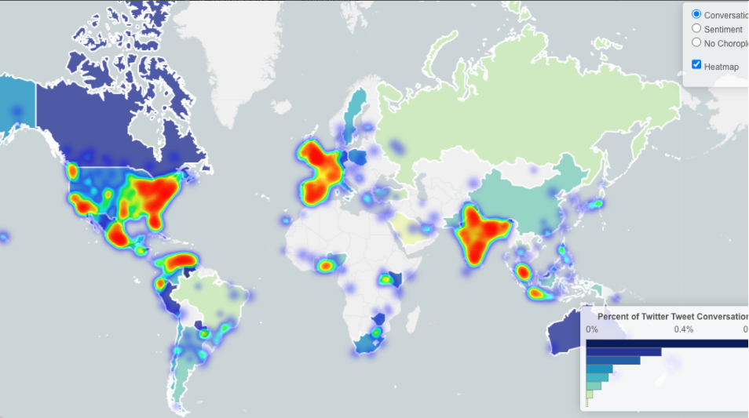
Web Mashups?
http://www.housingmaps.com/
https://www.expedia.com/
https://www.trendsmap.com/

Slide 4
What is IoT?
(at least in this talk)

Slide 5

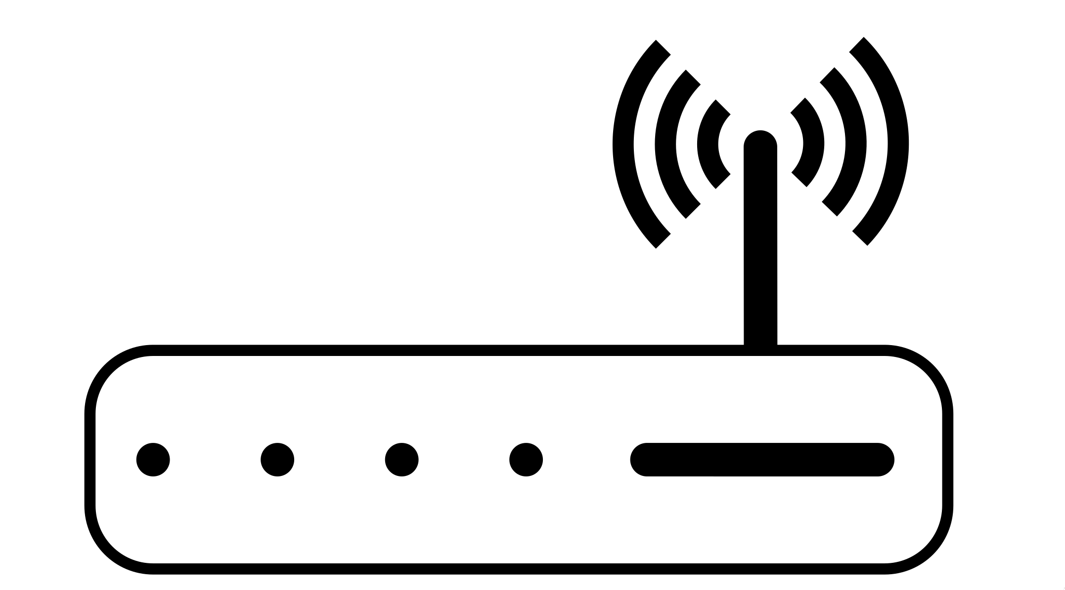






At least one way to look at it
IP based
IP based
IP Router
Local Network

Slide 6

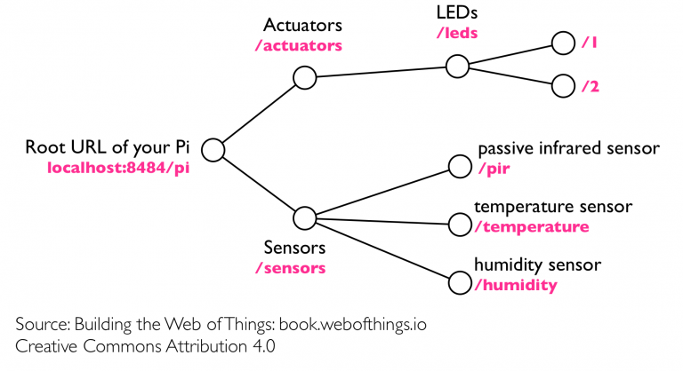
The Web of Things way to look at it

Slide 7
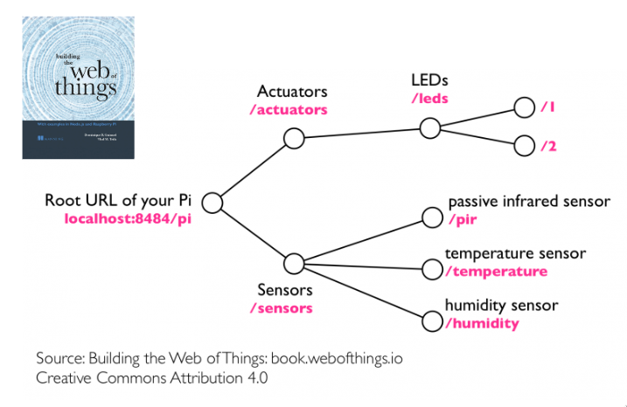


The Web of Things way to look at it
Was a proposal on how to build REST APIs for IoT devices
Is about describing any kind of API for IoT devices using any protocol

Slide 8
Now 4 normative deliverables, 93 participants over 35 organizations!

Slide 9

Web of Things: Thing Description (TD)
Abstract description of network APIs of IoT devices
Property, Action, Event
Semantic annotation of capabilities by other vocabularies over the Web: schema.org, SSN, ...
Concrete protocol description of individual devices

Slide 10
Why talk about standards in a Node.js summit?

Slide 11
Because it enables
Abstraction
Design Pattern
Protocol Agnostic Programming

Slide 12


Well also, the reference implementation is in Node.js
thingweb.io
Eclipse Thingweb node-wot
sane-city (Java)
dart_wot (Dart)
wot-py (Python)

Slide 13
Let’s see some code!

Slide 14
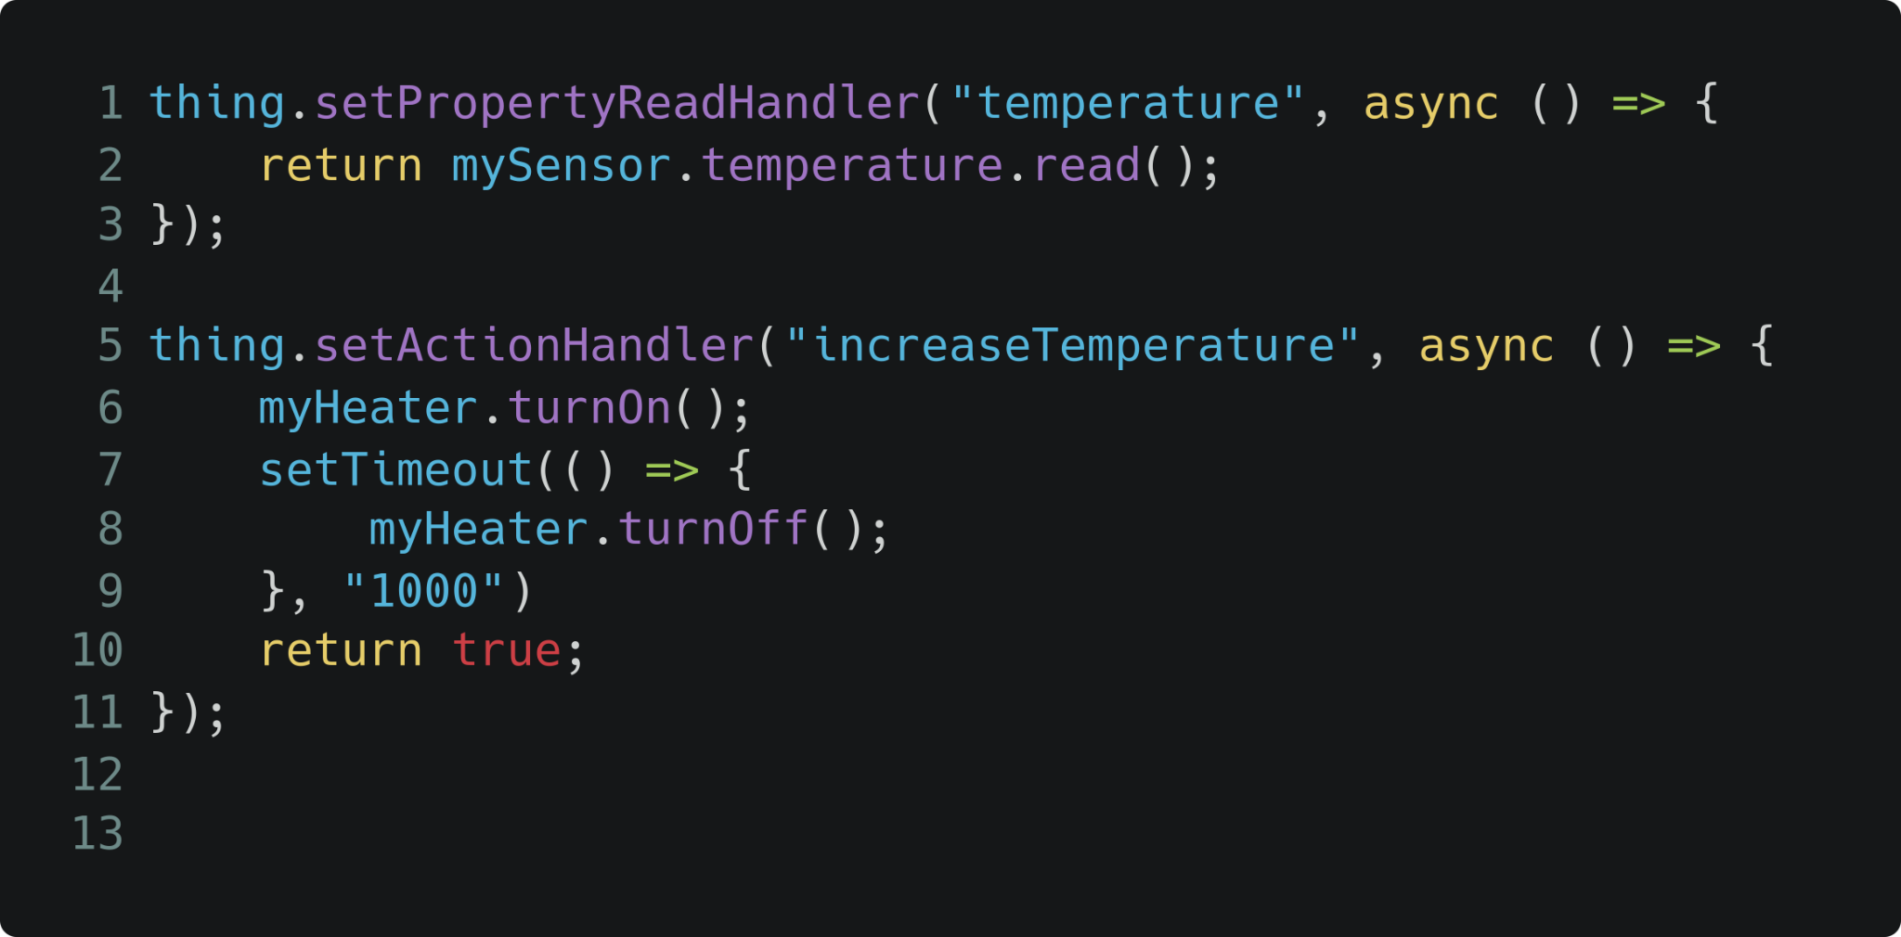
Code of a Thing
Notes:
thing.setPropertyReadHandler("temperature", async () => {
return mySensor.temperature.read();
});
thing.setActionHandler("increaseTemperature", async () => {
myHeater.turnOn();
setTimeout(() => {
myHeater.turnOff();
let currentTemp = mySensor.temperature.read();
if (currentTemp > 45) {
thing.emitEvent("overheat", count);
}
}, "1000")
return true;
});

Slide 15

What happens in the background
Browser
Device Hardware
Node.js
node-wot script
Node.js
Protocol Layer
Protocol Client
(Node.js) Application

Slide 16
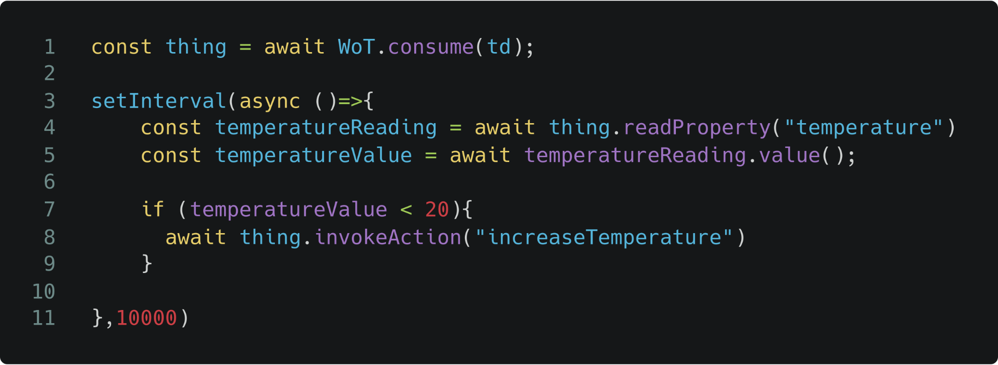
Code of a Thing Consumer
Notes:
const thing = await WoT.consume(td);
setInterval(async ()=>{
const temperatureReading = await thing.readProperty("temperature")
const temperatureValue = temperatureReading.value();
if (temperatureValue < 20){
await thing.invokeAction("increaseTemperature")
}
},10000)

Slide 17
What happens in the background
consume
Device Hardware
Custom
Protocol Layer
Protocol Layer
Node.js
node-wot script

Slide 18
How is this all possible?
First: Thing Descriptions

Slide 19
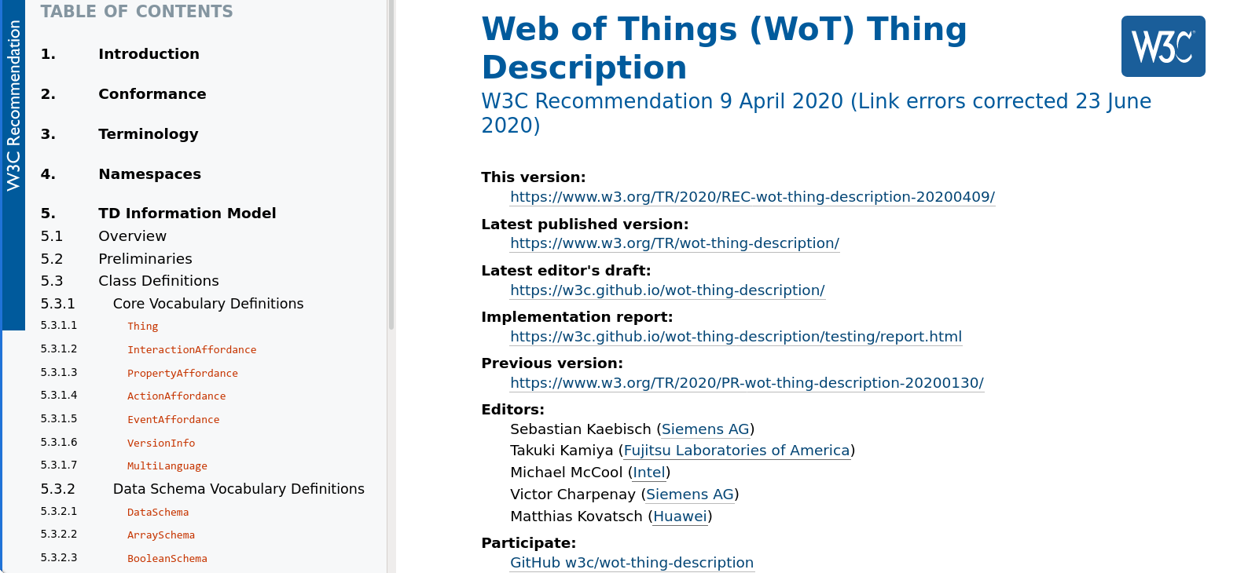
Deeper look into the Thing Description
Standardized JSON (-LD) document

Slide 20
Deeper look into the Thing Description: Thing Level
{
"@context": [
"https://www.w3.org/2022/wot/td/v1",
{"iot":"http://iotschema.org"}
],
"@type":"SprinklerStation",
"id": "urn:dev:ops:Agriculture-7331",
"title": "SoilStation",
"description": "A soil management station for use in agriculture",
"securityDefinitions": { "basic_sc": {"scheme": "basic"} },
"security": "basic_sc",
"properties": {
"temperature": {...}
},
"actions": {
"startSprinkler": {...}
},
"events": {
"tooDry": {...}
},
"links":["href":"docs", "rel":"about", "type":"text/html"]
}
Semantic Annotations
Thing
Metadata
Definitions of
Interaction Affordances
Security
Metadata
Links to other
Documents

Slide 21
Deeper look into the Thing Description: Interaction Level
"properties": {
"temperature": {
"title": "Temperature",
"type": "number",
"unit": "Celsius",
"forms": [...]
}
},
"actions": {
"startSprinkler":{
"description": "Run sprinkler for a set time",
"input": {
"type": "object",
"properties": {"timeout": {...}},
},
"forms": [...]
},
"events": {
"tooDry": {
"data": {"type": "string"},
"forms": [...]
}
}
JSON Schema
Interaction
Metadata
Concrete
Protocol Information

Slide 22
Deeper look into the Thing Description: Protocol Level
{
"forms": [
{
"href": "http://example.com/light/currentdimmer",
"contentType": "application/json",
"op": "readproperty",
"htv:methodName": "GET"
},
{
"href": "mqtt://example.com/example/light/currentdimmer",
"op": "observeproperty",
"mqv:controlPacketValue": "SUBSCRIBE"
}
]
}
Protocol and URI
of the Resource
Protocol Specific Vocabulary
Intended WoT
Operation

Slide 23
How is this all possible?
Second: node-wot :)

Slide 24
How to get running
Install the Dependencies
npm install @node-wot/core (mandatory core component)
npm install @node-wot/binding-coap (optional bindings)
Include them
Servient = require("@node-wot/core").Servient;
HttpServer = require("@node-wot/binding-http").HttpServer;
Or use the CLI by following our Readme

Slide 25
Different Protocol Options
You can use node-wot with Internet protocols:
HTTP and HTTPS
CoAP and CoAPS
MQTT
Google Firestore
Websocket (Server-side)
NETCONF (Client-side)
and even with some industrial automation protocols:
OPC-UA (Client-side)
Modbus (Client-side)
M-Bus (Client-side)
and more that you can simply implement over a protocol interface

Slide 26
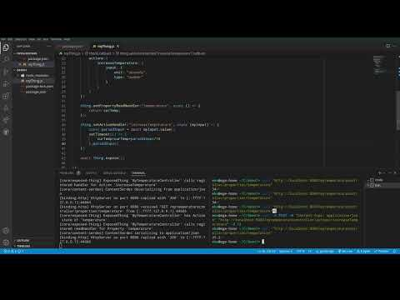

Slide 27
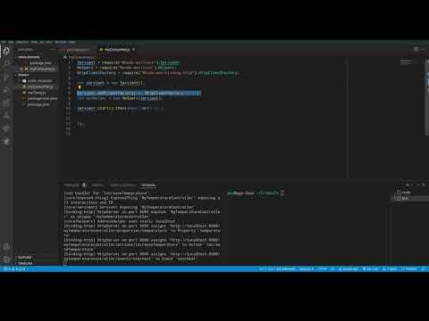

Slide 28

Give node-wot a try!
and/or a star a GitHub to support the development

Slide 29
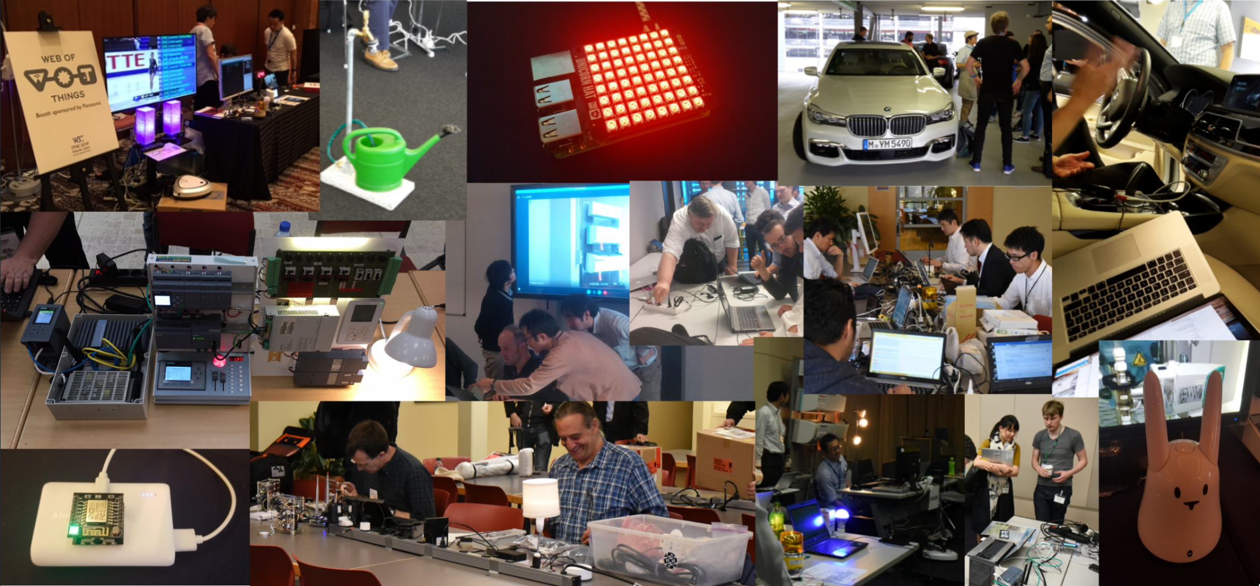
Mashups at Standardization Events

Slide 30
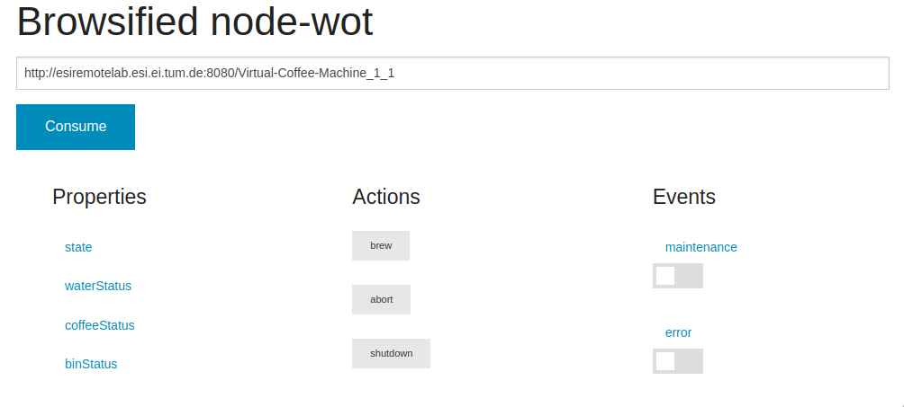
On the Browser
Simple demo hosted at http://plugfest.thingweb.io/webui/

Slide 31
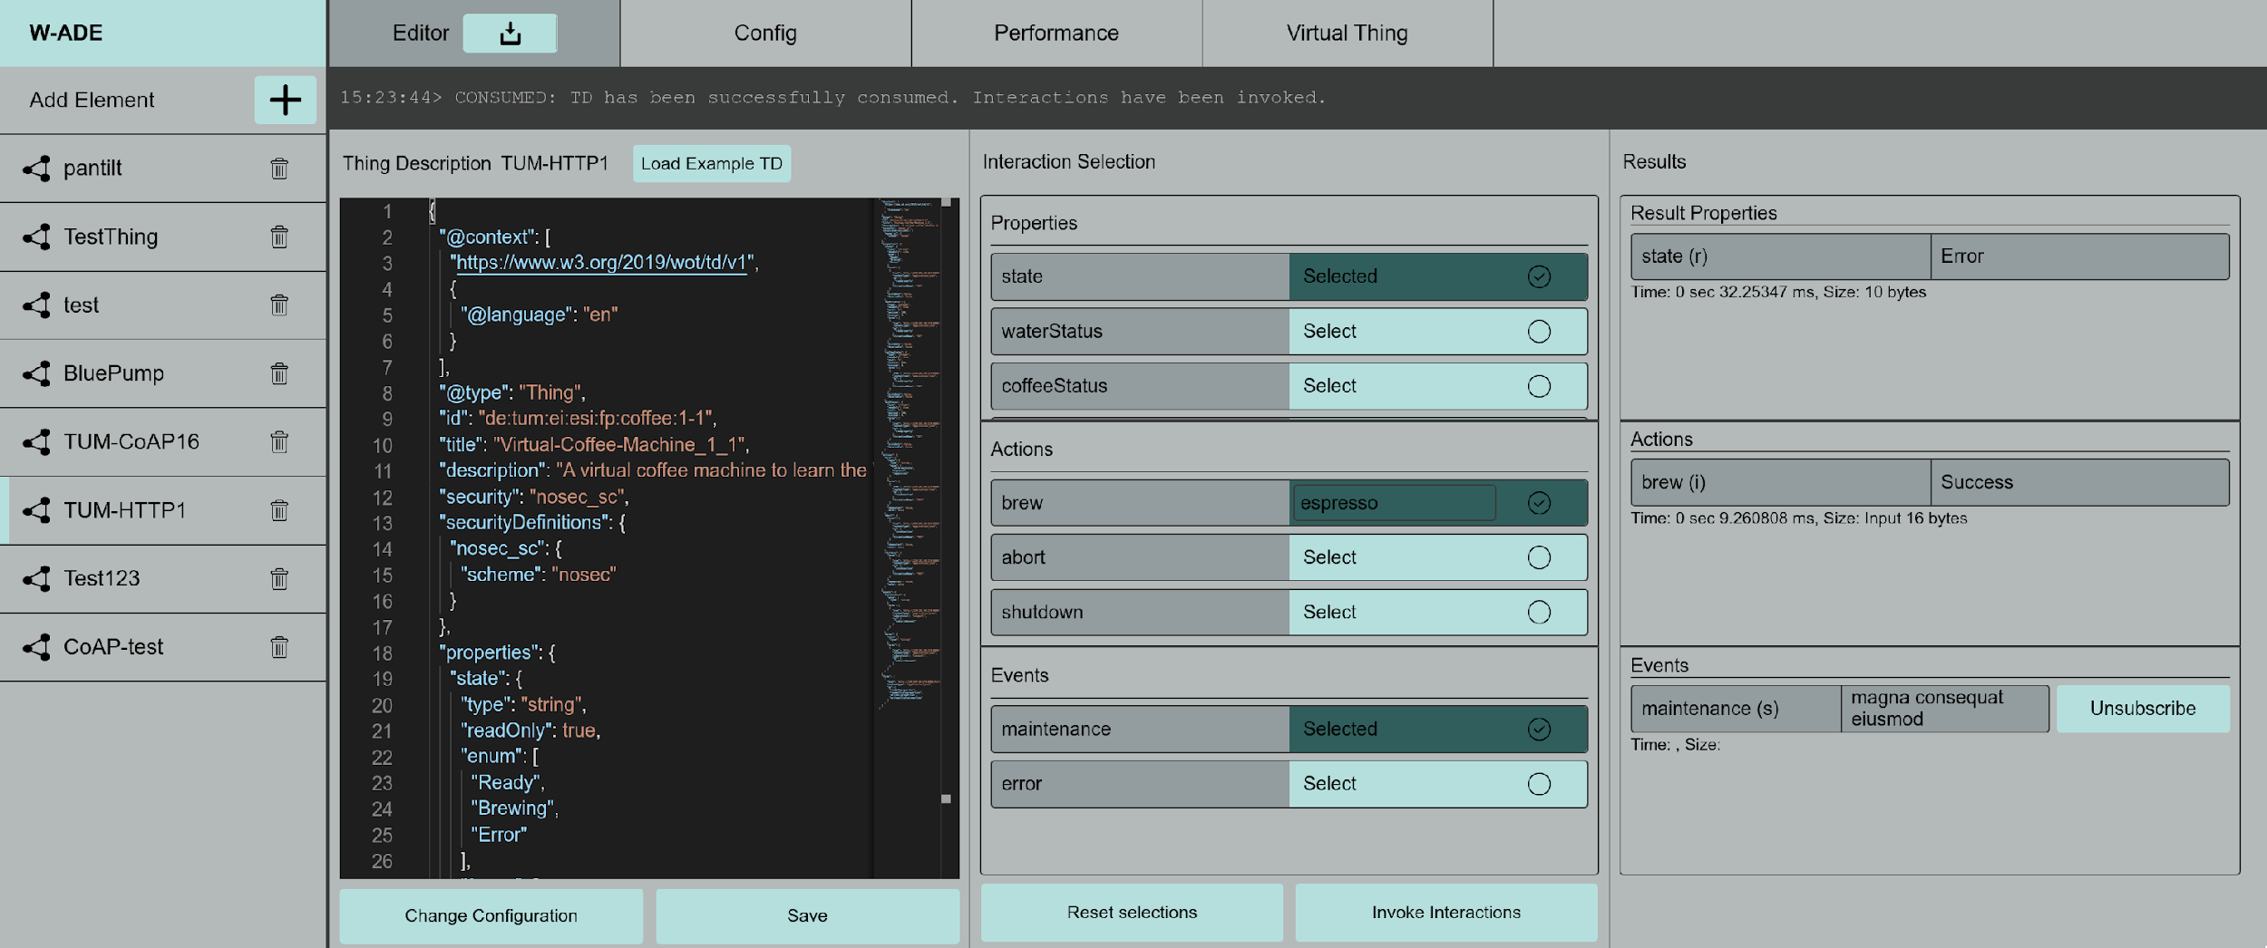
Desktop Applications
Available at https://github.com/tum-esi/wade

Slide 32
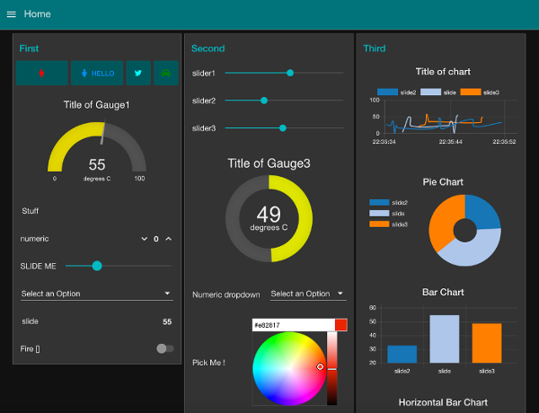

And more!
*
Proxies
CoAP
HTTP
node-wot
HTTP
*
*
MQTT
Dashboards
Simulators
Firestore
https://flows.nodered.org/node/node-red-dashboard

Slide 33
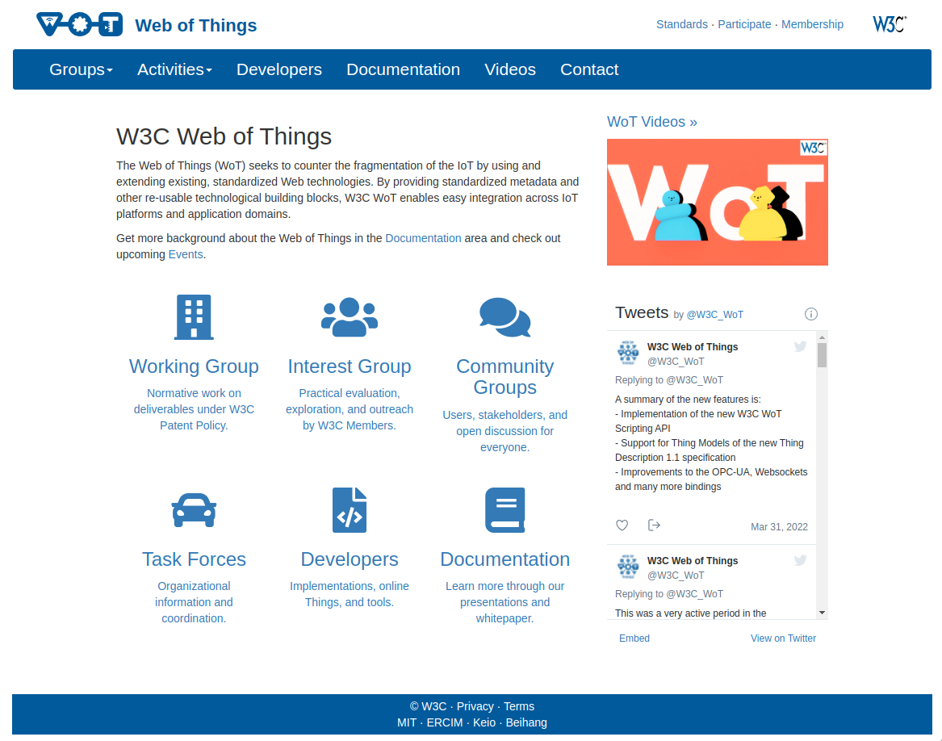

For more on Web of Things and node-wot
W3C Web of Things
Eclipse Thingweb node-wot
https://www.w3.org/WoT/
https://www.thingweb.io/
@W3C_WoT

Slide 34


Contact
Published by Siemens
Ege Korkan
Research Scientist T CED EWT
Phone +49 173 9401758
E-mail ege.korkan@siemens.com
Twitter: @egekorkan
GitHub: @egekorkan

